Slide 1

Robust Malicious Domain Detection
Authors: Chen Hajaj , Nitay Hason , Nissim Harel, and Amit Dvir.
By : Lee Kochav & Eliel Gez

Slide 2
Article Background
This research is about malicious url detection , research intro - In our everyday life we manage personal risk and infer which situations may be dangerous and avoid them accordingly. However, it translates poorly to the context of the malicious URLs, there are few effective heuristics to differentiate safe URLs from dangerous ones.
Our main goal was to find features that will be usefull along with their 4 novel features to make good calssify with 6 robust features, we did it successfully as can be seen in the results at the presentation.

Slide 3
The Problem
Malicious URLs are a links created with the purpose of promoting scams, attacks, and frauds
Naturally, we want to have systems that can recognize whether a URL is malicious or benign
What if the attacker knows by which parameters the URL is classified?

Slide 4
Methodology
Data Collection
Feature Engineering
Robust Feature Selection
Novel Features

Slide 5
Base Features
Length of the domain - non robust
Number of consecutive characters - robust
Entropy of the domain - non robust
Number of IP addresses - non robust
Distinct Geo-Location of IP addresses - non robust
Mean TTL value - robust
STD of the TTL value - non robust
Life time of the domain - semi robust
Active time of the domain - semi robust

Slide 6
Novel Features
Communication Country Rank
Communication ASNs Rank
Number of passive DNS changes
Remaining time of SSL certification

Slide 7
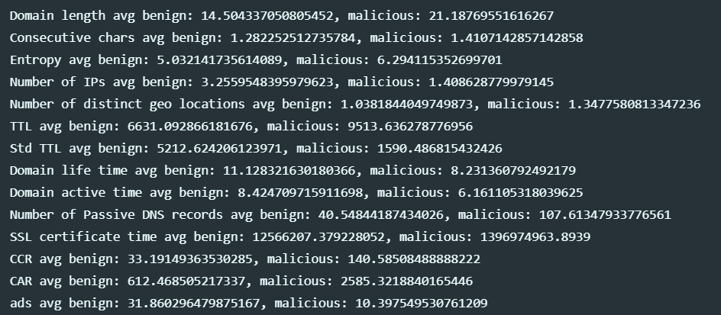
Data Exploration
Web content length
Builtwith platform
Selenium docs
Several API’S

Slide 8
Our Work
To create new features that will reduce the dependency on non robust features such as domain length, entropy, etc.
Use Builtwith site to check each domain and explore it content such as length, number of ads.
Developed crawler that fetch domains from bigspy website , which contains ads from social media
Filtered domains from the crawler by DNS query (active or not)

Slide 9
Problems we faced:
A large percentage of malicious URLs were not available anymore
Obtained a new malicious URL Dataset from Phishtank
Develop new crawler to fetch domains from bigspy
RiskIQ’s API changed to community API

Slide 10
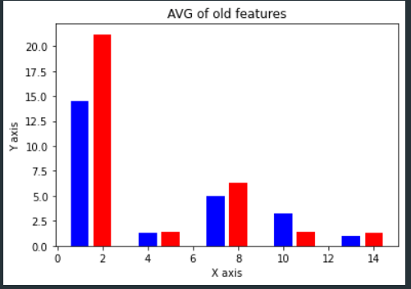
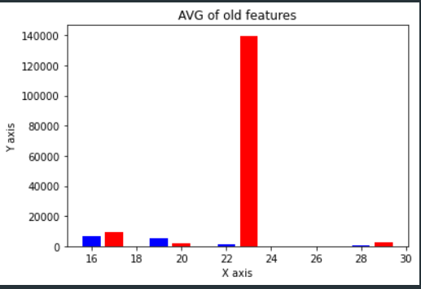
Old features statistics:

Slide 11
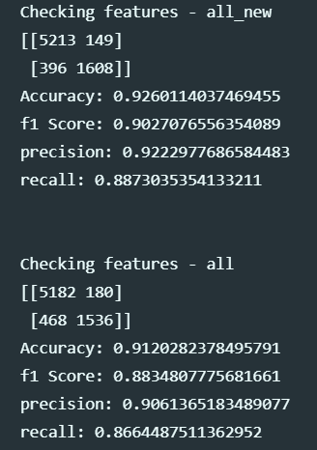
Results – Logistic Regression

Slide 12
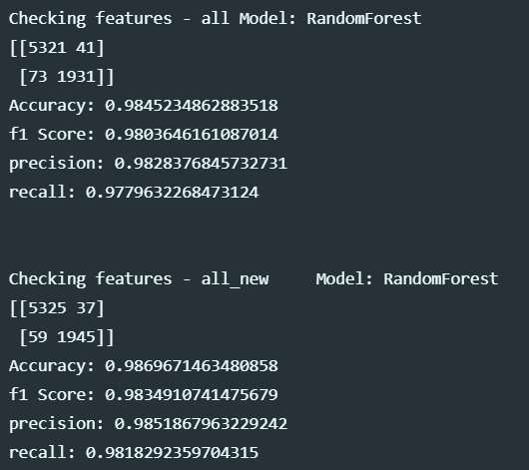
Results – Random Forest

Slide 13
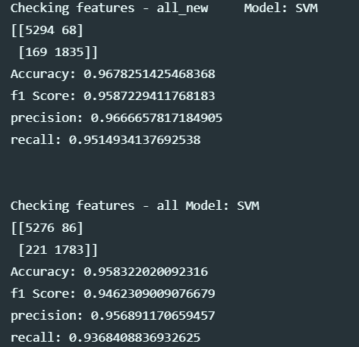
Results - SVM

Slide 14
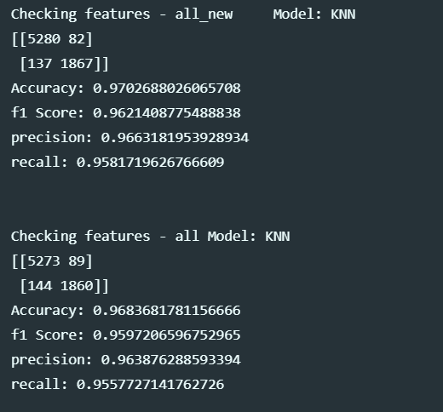
Results - KNN

Slide 15
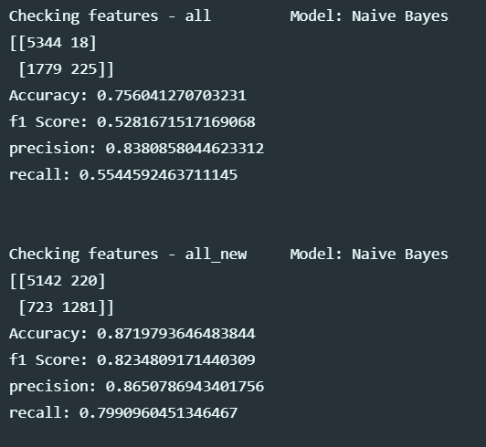
Results – Naïve Bayse

Slide 16
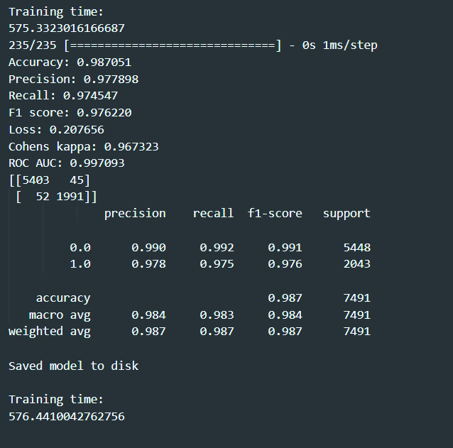
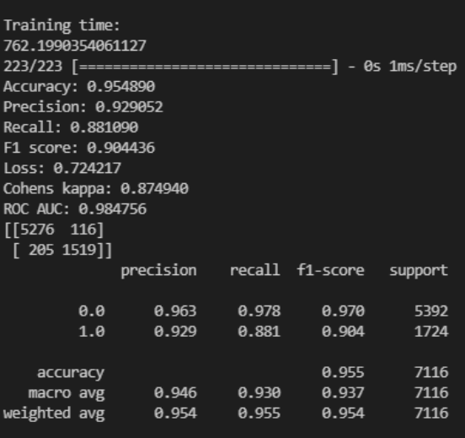
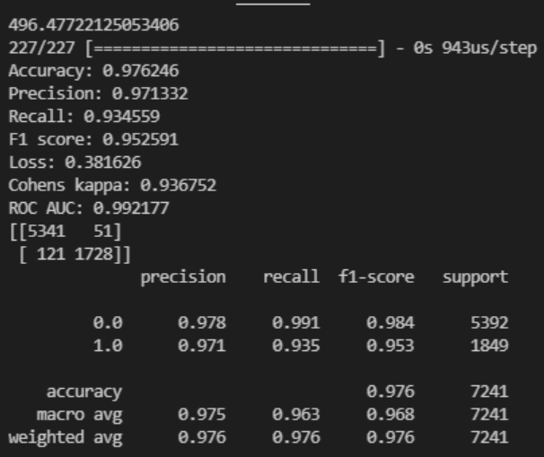
ANN RESULTS:

Slide 17
THANK YOU

